Slide 1

KAPITAL SUG`URTA
Your insurance company
www.kapitalsugurta.uz

Slide 2


www.kapitalsugurta.uz
Achievements of the company in the insurance market /
according to the results. For 2023
for insurance payments
( in the general insurance industry)
More than 882 931
existing agreements, of which:
6
3
329 765
legal entities
553,166 individuals
place
place
Fitch Ratings
rating - B
forecast - stable
SNS Ratings
rating – AAA-
forecast - stable
for collection of insurance premiums

Slide 3
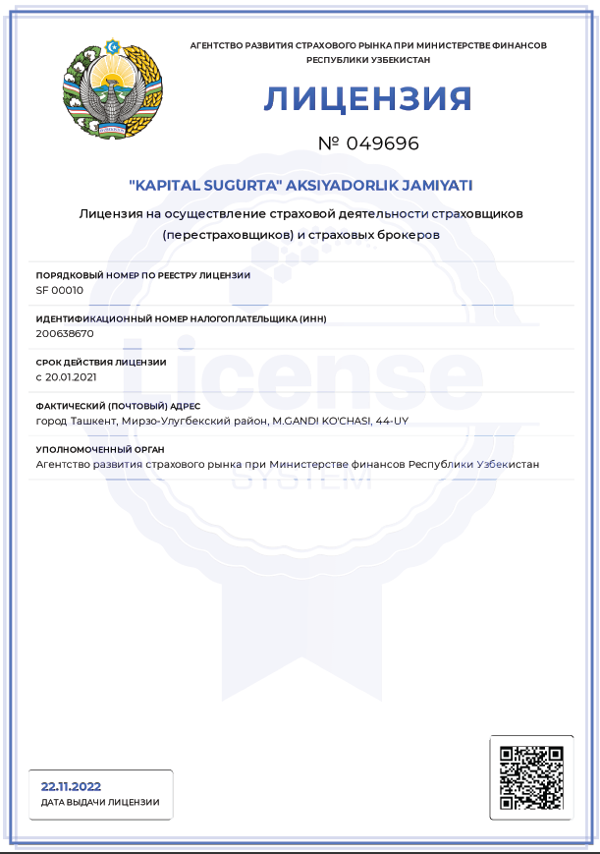
www.kapitalsugurta.uz
Authorized capital and license
Activities:
Insurance activities, including mandatory types
Reinsurance activities
Investment activities
Mediation as an insurance agent
Investment intermediation
Survey and adjuster services for foreign insurers
Sale or rental of property
Advanced training of specialists in the field of insurance (reinsurance)
Authorized capital:
45 billion UZS
9 billion UZS
Preference shares
36 billion UZS
Common shares

Slide 4
www.kapitalsugurta.uz
2023
61
February
1991
branches and offices
Creation of the first non-state insurer
Us 31 years
countrywide!
KAPITAL SUG'URTA
In our state
224
93
employees in the company
insurance agents

Slide 5
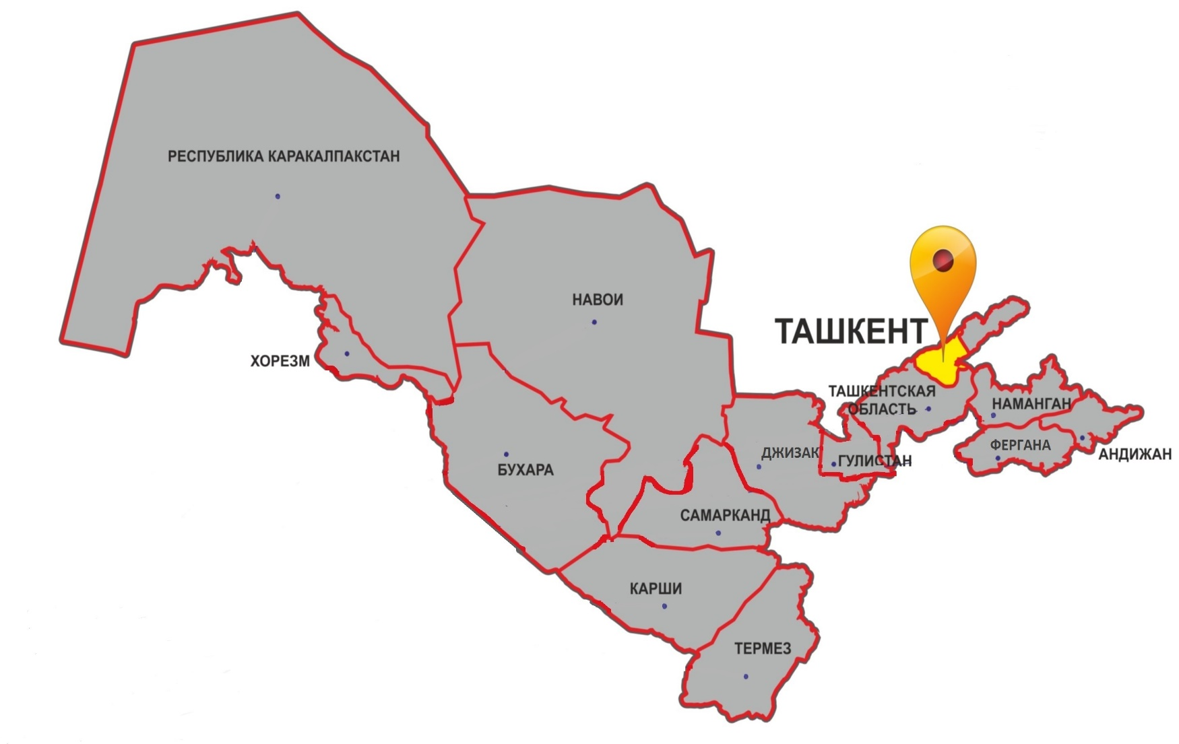
www.kapitalsugurta.uz
Regional divisions
Number of operating units
2022 year
64 structural divisions
2023 year
61 structural divisions
Of them:
14​ branches and 4 7 branches in all administrative
centers of the country's regions;
1 branch and 10 insurance centers in the city of Tashkent.

Slide 6
www.kapitalsugurta.uz
Insurance premiums
by the end of 2022 – 2023 years (million UZS )
Volume of collected insurance premiums, million UZS
100.6 % increase

Slide 7
34.2 %
www.kapitalsugurta.uz
Insurance premiums
at the end of 2022 – 2023 (million UZS )
Comparative chart of received insurance premiums
Comparative chart of the shares of existing contracts by their number ( pcs , %)
2022​
2023

Slide 8
www.kapitalsugurta.uz
Insurance premiums by type of insurance
by the end of 2023 (million UZS )
Share of Compulsory civil liability insurance for vehicle owners in terms of compulsory types of insurance, million UZS
Share of financial risk insurance in relation to other types of insurance, million UZS

Slide 9
www.kapitalsugurta.uz
Comparative chart of received insurance premiums by region at the end of 2022 -2023 (million UZS )

Slide 10
www.kapitalsugurta.uz
Implementation of the Business Plan for insurance premiums by region based on the results of -2023 (million UZS )

Slide 11
34.2 %
www.kapitalsugurta.uz
Insurance payments
based on the results of the 2022 – 2023 years (million UZS )
Insurance payments,
million UZS
191.8 % growth

Slide 12
www.kapitalsugurta.uz
Insurance payments
2022 – 2023 years (million UZS ) by region
Comparative chart of insurance payments , million UZS
Comparative chart of shares ( number of settled insurance claims ( pieces )
2022 year
2023 year

Slide 13
www.kapitalsugurta.uz
Insurance payments by type of insurance based on results
2023 (million UZS )

Slide 14
www.kapitalsugurta.uz
Comparative chart of insurance benefits paid by region based on the results of the 2022 –2023 years (million UZS )

Slide 15
www.kapitalsugurta.uz
Investment activities
Volume of investments, million UZS
Dynamics of changes in deposits, million UZS
152.5% increase
145.0% increase

Slide 16
www.kapitalsugurta.uz
Investment activities
Types of investments for 2023, million UZS

Slide 17
34.2 %
www.kapitalsugurta.uz
Financial indicators based on the results
2023, million UZS

Slide 18


Thank you for your attention!
100011, Uzbekistan, Tashkent, Mirzo-Ulugbek district, st. Mahatma Gandhi, 44
Tel: (+71 ) 200 1100, 232 0202, 237 5599
E-mail: info@ksc.uz, office@ksc.uz
Website: www.ksc.uz

